Slide 1
Geometric Proofs
L.O. Understand what a geometric proof is and use proofs to explain answers

Slide 2
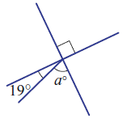
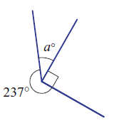

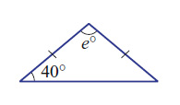
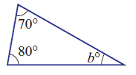
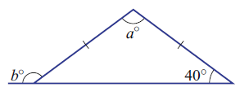
Start up.
Find the value of the pronumeral in each of these.

Slide 3
How do you know?
Is this a square?
How about now?
What about now?
So how do you explain why you know it is a square?
Because - It is a 4 sided shape
Because - All sides are the same length
Because - All angles are right angle
Therefore it must be a square.

Slide 4
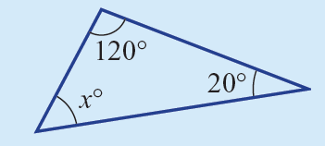
How do we know the angle is 40º?
Because - It is a triangle
Because - The angles in triangles always add to get 180º.
Because - 120º + 20º + xº = 180º
Therefore xº must equal 40.

Slide 5
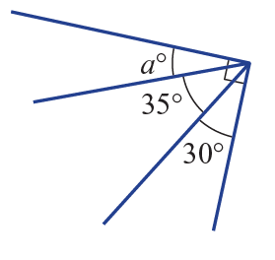
How do we know angle a is 15º?
Because - It is a right angle
Because - Right angles always add to get 90º.
Because - 30º + 35º + aº = 90º
Therefore aº must equal 15.

Slide 6
Similarity
Last lesson we learnt about Similarity
Similar triangles are triangles having the same shape but different size.
Two triangles are similar if they obey ANY ONE of these conditions:
Either
(1) Two angles on one triangle are equal to two angles on the other (AA)
Or
(2) All three pairs of sides have the same scale factor (SSS)
Or
(3) Two pairs of sides have the same scale factor, AND the angle between them are equal (SAS)
Or
(4) In a right angled triangle only, the hypotenuses and one other pair of sides have the same scale factor. (RHS)

Slide 7

Proofs
EQ – How do we write a proof?
A proof is a statement where we write why we know something is true.
With similar triangles we use the similar triangle rules to create a proof.

Slide 8
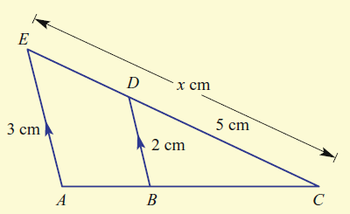
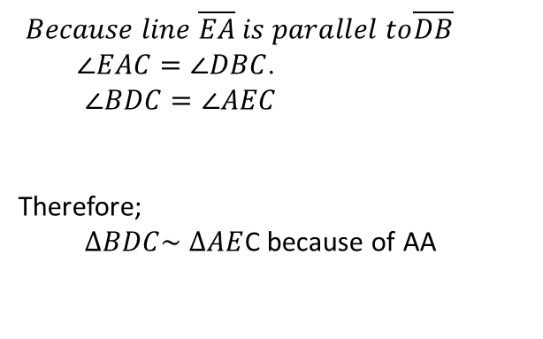
Proofs
EQ – How do we write a proof?
A proof is a statement where we write why we know something is true.
With congruent triangles we use the congruent rules to create a proof.
1. List all of the sides and angles that match between the two triangles.
2. Decide which similarity rule is complete.
3. Finish with a statement of similarity and state which rule proved this.
$Because line \overline{EA} is parallel to\overline{DB}$
$∠EAC=∠DBC$.
$∠BDC=∠AEC$
Therefore;
$∆BDC\sim$ $∆AE$C because of AA

Slide 9
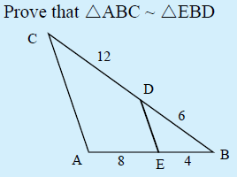
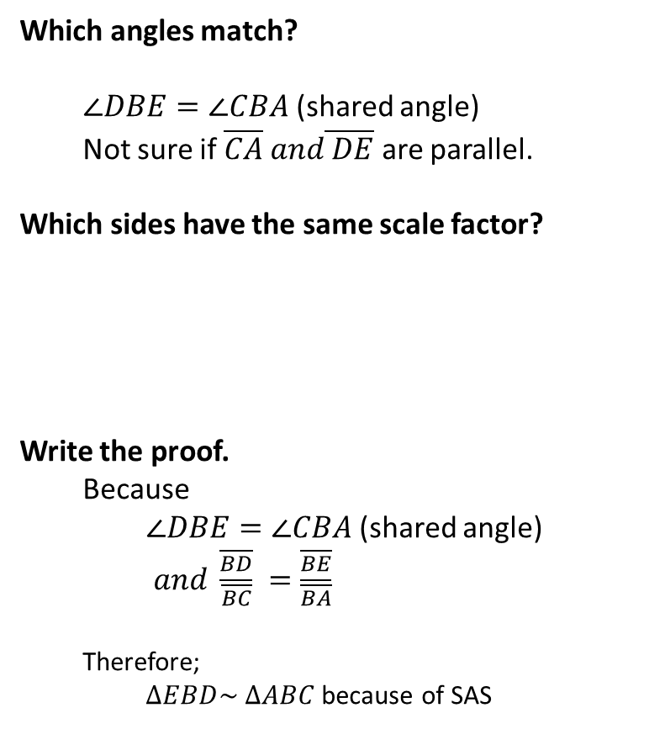


Which angles match?
$∠DBE=∠CBA$ (shared angle)
Not sure if $\overline{CA} and\overline{ DE}$ are parallel.
Which sides have the same scale factor?
Write the proof.
Because
$∠DBE=∠CBA$ (shared angle)
$and \frac{\overline{BD}}{\overline{BC}} =\frac{\overline{BE}}{\overline{BA}}$
Therefore;
$∆EBD\sim$ $∆ABC$ because of SAS
We do
$\frac{\overline{BD}}{\overline{BC}} =$ $\frac{6 cm}{12cm}=\frac{1}{2}=0.5$
$\frac{\overline{BE}}{\overline{BA}} =$ $\frac{4 cm}{8cm}=\frac{1}{2}=0.5$
SAS | 2 sets of sides have the same scale factor and the angle between is the same
AA | 2 Angle’s match
SSS | All 3 sides have same scale factor
RHS | Both are right angled, Hypotenuse and another set of sides have the same scale factor

Slide 10
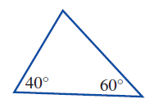
Which angles match?
Which sides have the same scale factor?
Write the proof.
You do
E
B
D
F
A
C
SAS | 2 sets of sides have the same scale factor and the angle between is the same
AA | 2 Angle’s match
SSS | All 3 sides have same scale factor
RHS | Both are right angled, Hypotenuse and another set of sides have the same scale factor

Slide 11
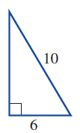
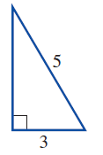
X
Which angles match?
Which sides have the same scale factor?
Write the proof.
You do
S
R
T
Y
Z
SAS | 2 sets of sides have the same scale factor and the angle between is the same
AA | 2 Angle’s match
SSS | All 3 sides have same scale factor
RHS | Both are right angled, Hypotenuse and another set of sides have the same scale factor

Slide 12
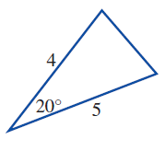
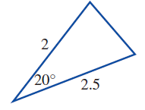
Which angles match?
Which sides have the same scale factor?
Write the proof.
You do
I
G
L
H
M
N
SAS | 2 sets of sides have the same scale factor and the angle between is the same
AA | 2 Angle’s match
SSS | All 3 sides have same scale factor
RHS | Both are right angled, Hypotenuse and another set of sides have the same scale factor

Slide 13
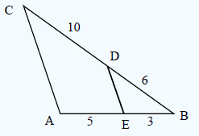
Which angles match?
Which sides have the same scale factor?
Write the proof.
You do
SAS | 2 sets of sides have the same scale factor and the angle between is the same
AA | 2 Angle’s match
SSS | All 3 sides have same scale factor
RHS | Both are right angled, Hypotenuse and another set of sides have the same scale factor

